Slide 1
5703 Group Based Capstone Project
Week 3 Tutorial Presentation
Project Number: CS03-1
Project Title: Use of machine learning to
predict the foot progression
angle during gait in people
with knee osteoarthritis
Presenters: Feixiang Wang, Mohan Xi,
Ruhao Ji, Weijia Chi,
Tonghuan Liu, Yang Guo

Slide 2
Summary of the most recent client meeting
[Presenter with fwan0760]
Date of Meeting: 2025/3/10
Key Points Discussed:
Weekly Meeting Format, Time and Location
Project Introduction and Data Example
Group member Background Introduction
Related Knowledge We Need to Learn
Client Feedback and Requests:
Feedback 1: A Lab in Susan Wakil Health Building that we can use in meeting
Feedback 2: Good machine Learning basis
Request 1: Learn the Model CGM2.4 and read the book "The Comprehensive Textbook of Biomechanics"
Request 2: Learn how to process video data

Slide 3
Recap of Last Week’s Plan
[Presenter with fwan0760]
Planned Tasks/Goals from Last Presentation:
Task/Goal 1: Ensure the weekly meeting format with client
Task/Goal 2: Get the data from client
Task/Goal 3: Project details and what we need to learn to finish the project
Task/Goal 4: How to assign tasks in our group
Task/Goal 5: Create the slack working space and Github project

Slide 4
Group Progress
[Presenter with fwan0760]
Achievements since Last Presentation
Progress 1: Hold the first meeting with client and ensure the weekly meeting format in future
Progress 2: Get the data example and introduction. However, client told us we cannot get whole data until next weekly meeting (next Monday)
Progress 3: Get some materials from client.
Progress 4: Ensure the group organization.
Alignment with Client/Project Requirements
We need to determine the format of the weekly meetings (which has already been decided) and client hopes that we learn some relevant knowledge (which is already in our plan throughout the semester, with the client providing relevant guidance materials).

Slide 5
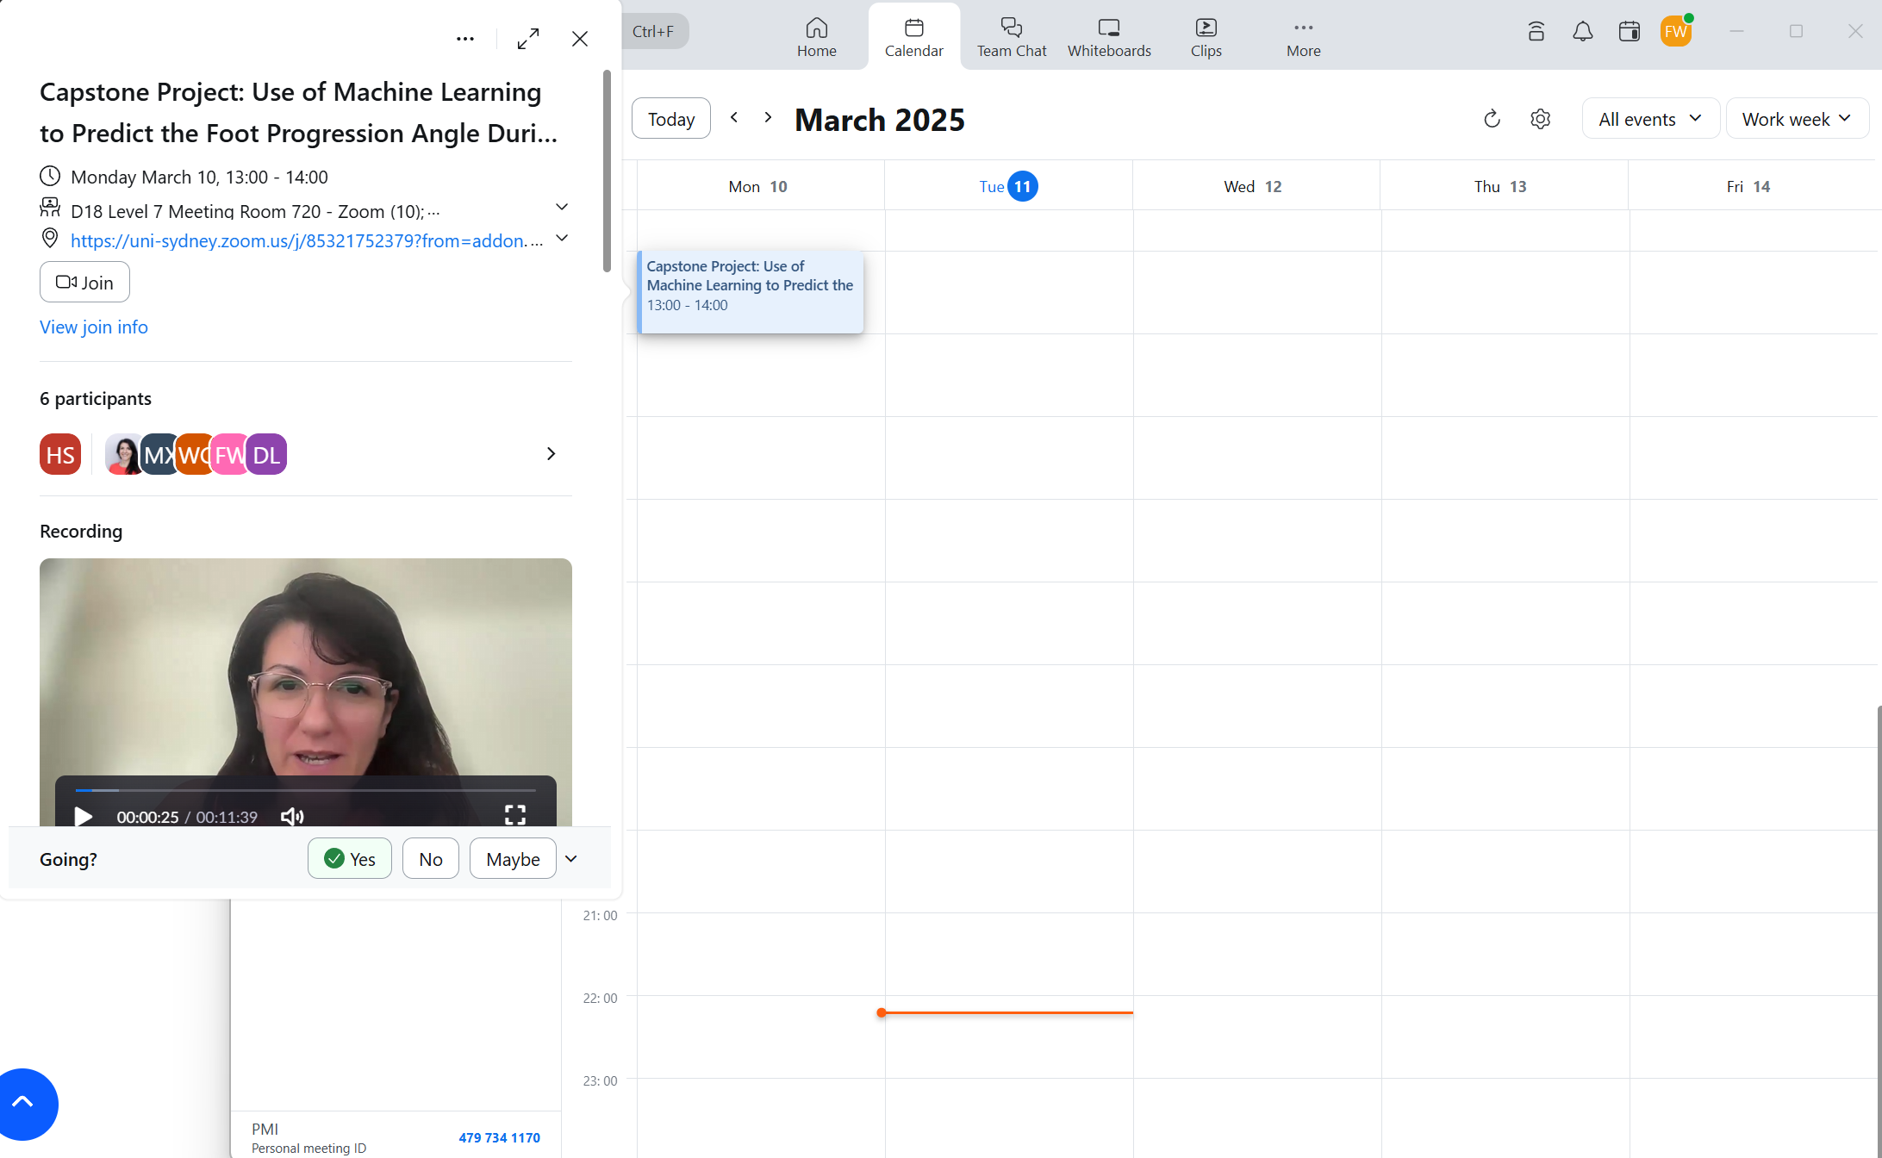
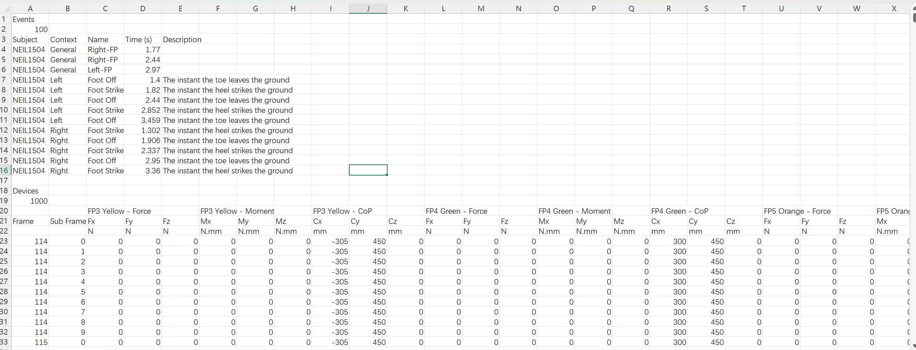
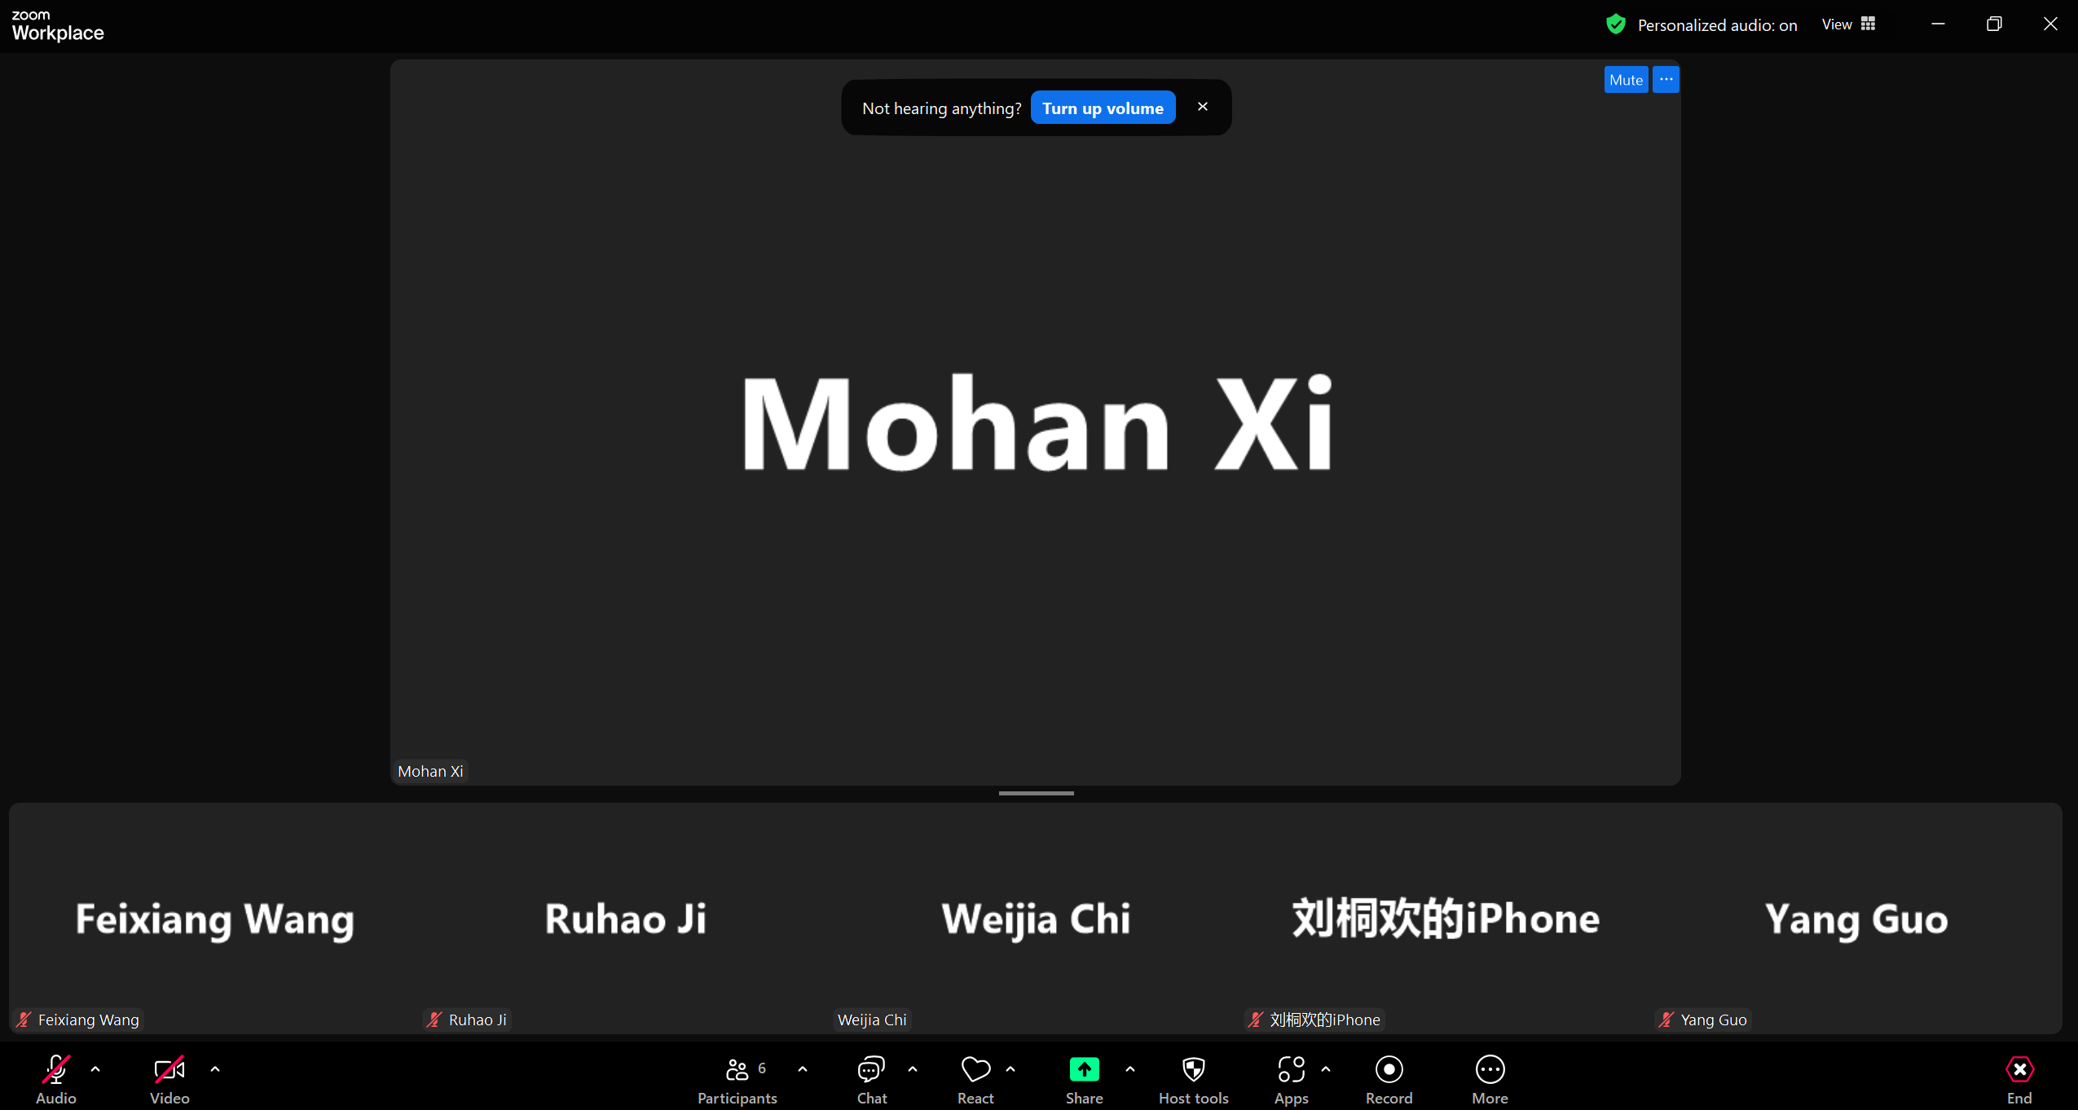
Group Progress Evidence
[Presenter with fwan0760]
Screenshot / Demo
Data example
Meeting with Client
Group Meeting

Slide 6
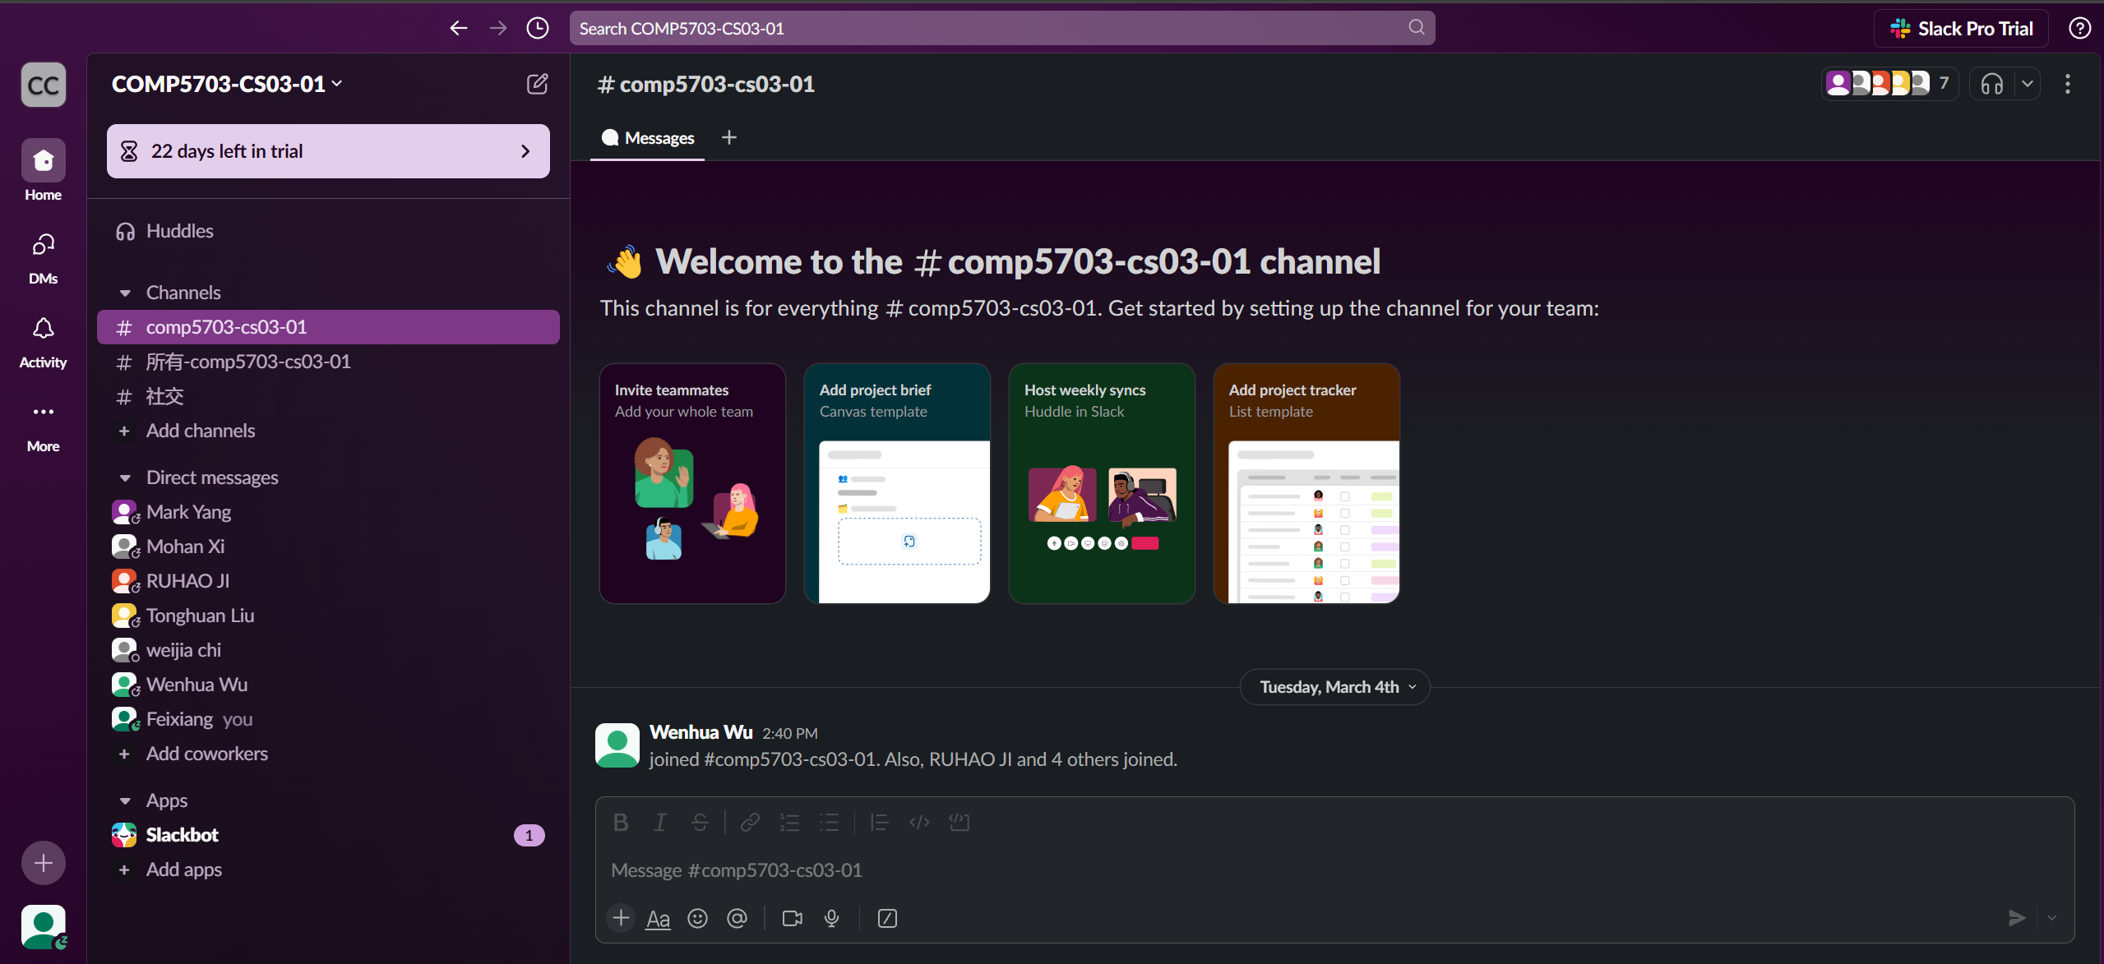
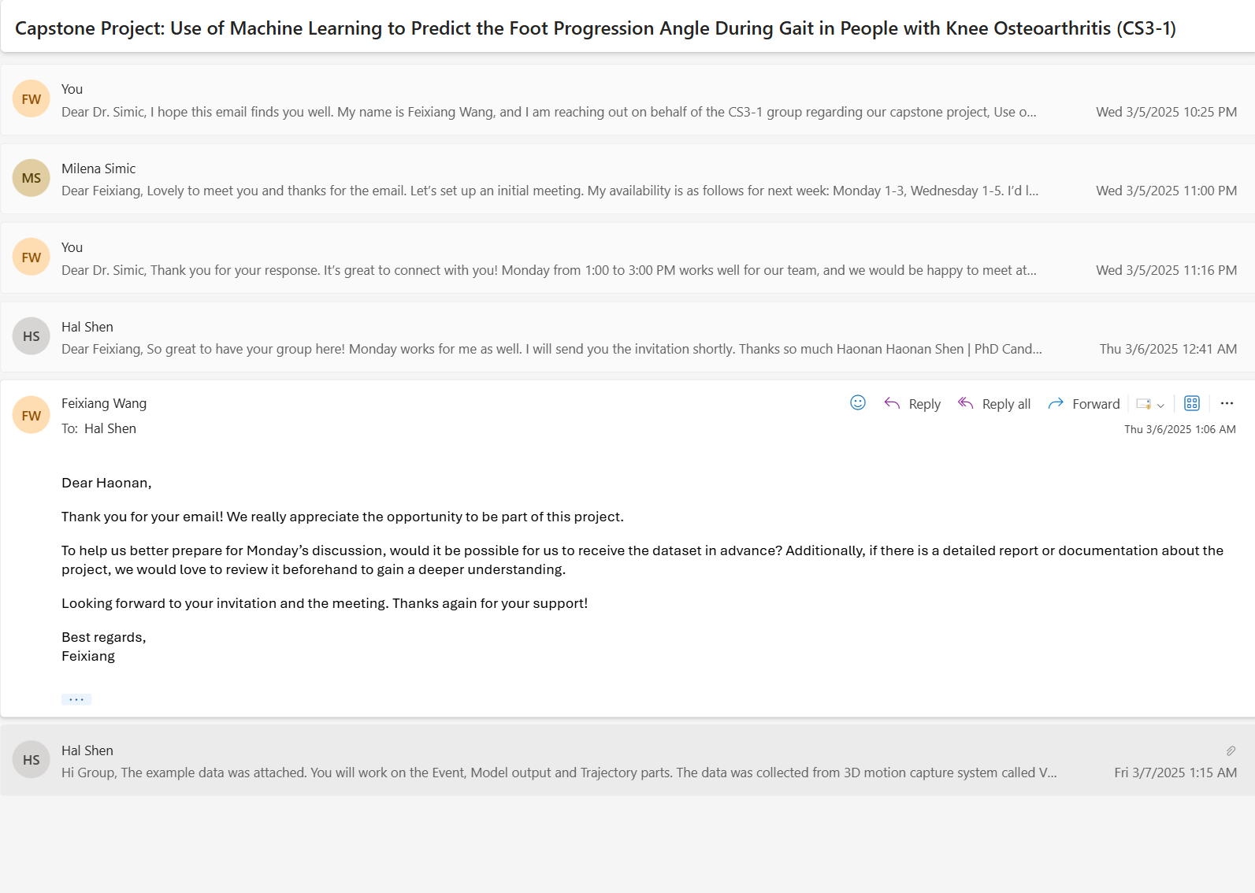
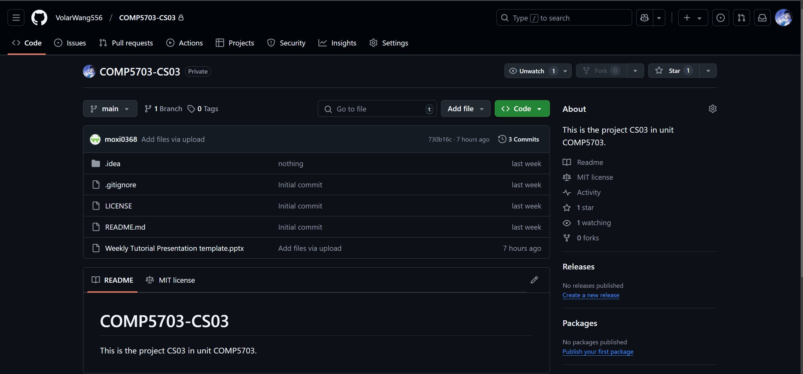
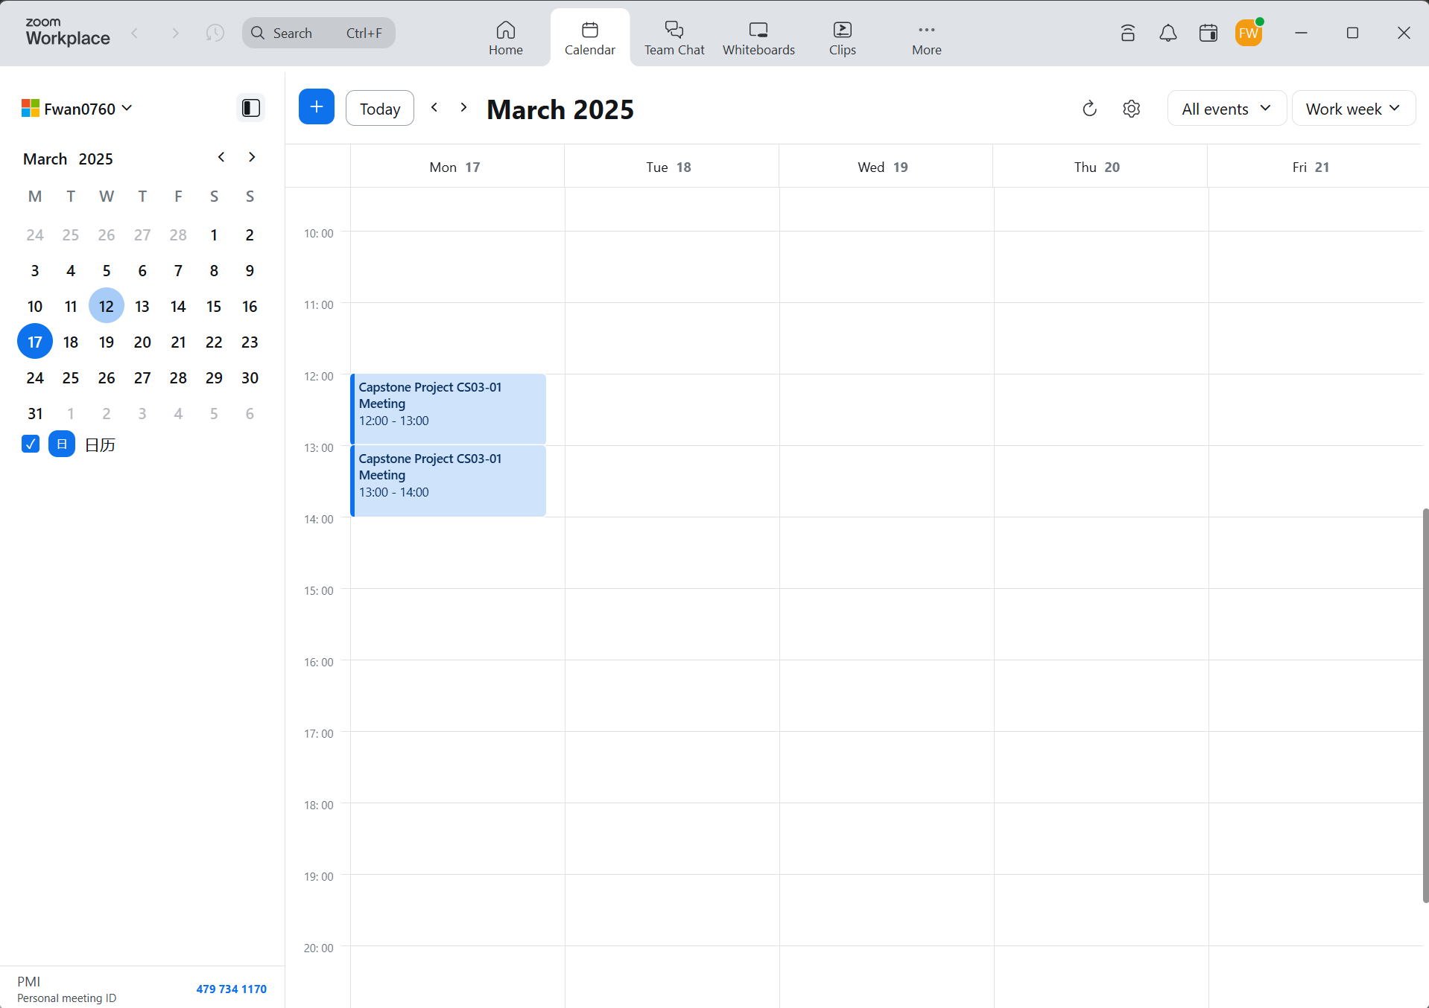
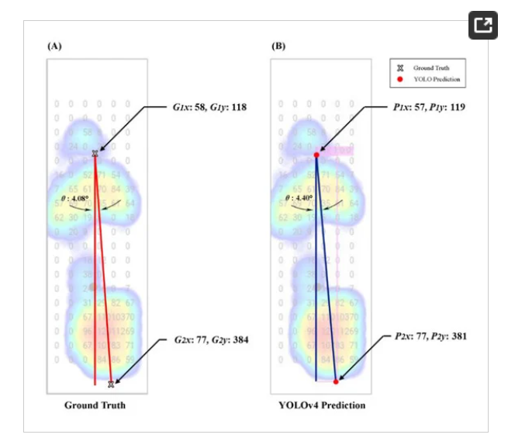
Individual Progress – Member 1
[Presenter with fwan0760]
Screenshot / Demo
Screenshot /
Create the Slack working space and send the invitations to my group members and tutor.
Create the github project and send the invitations to my group members and tutor.
Communicate with client and ensure the first meeting time, location and format
Learn the knowledge about Biomechanics
Organize the Weekly Meeting in Future
Read some papers related to this project

Slide 7
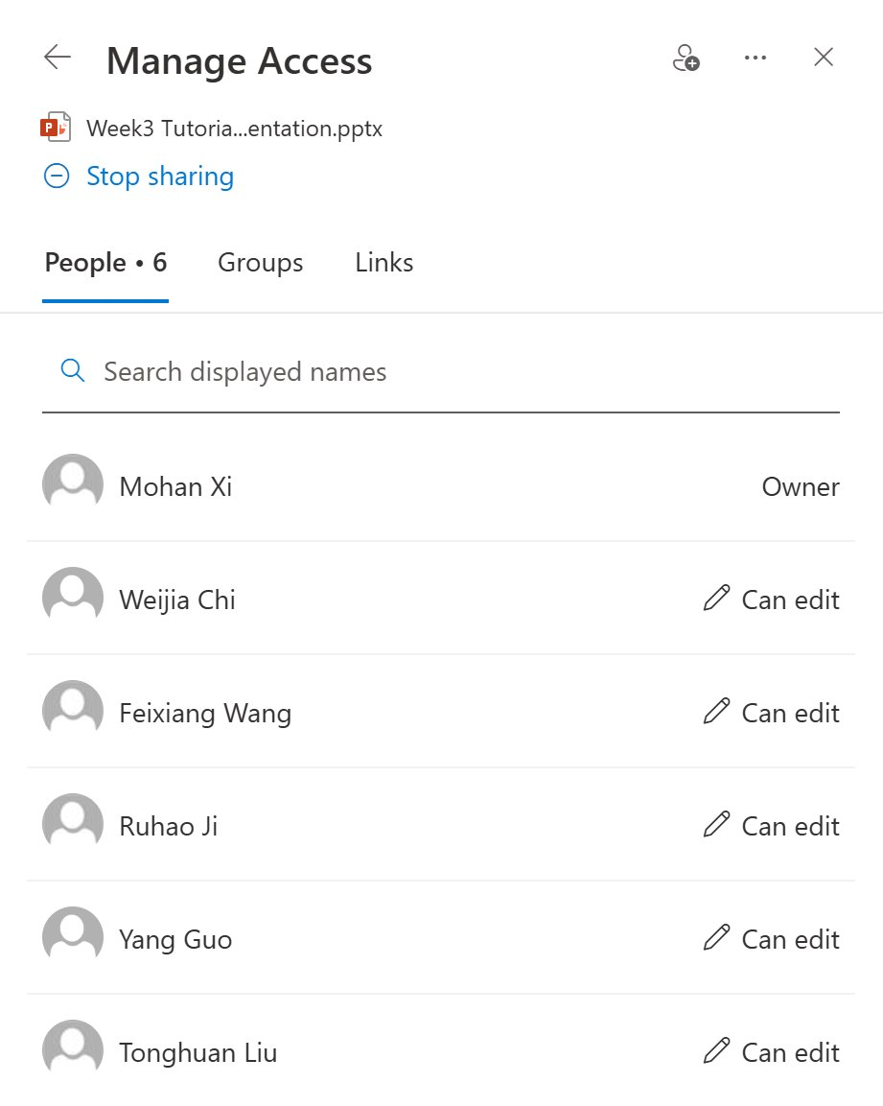
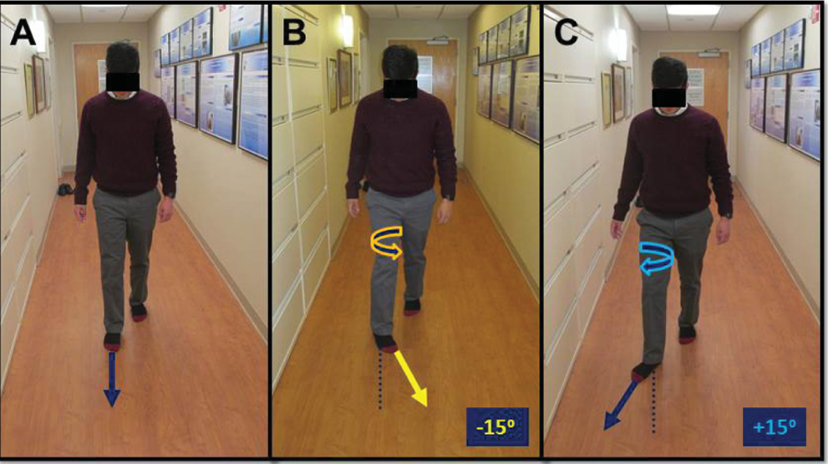
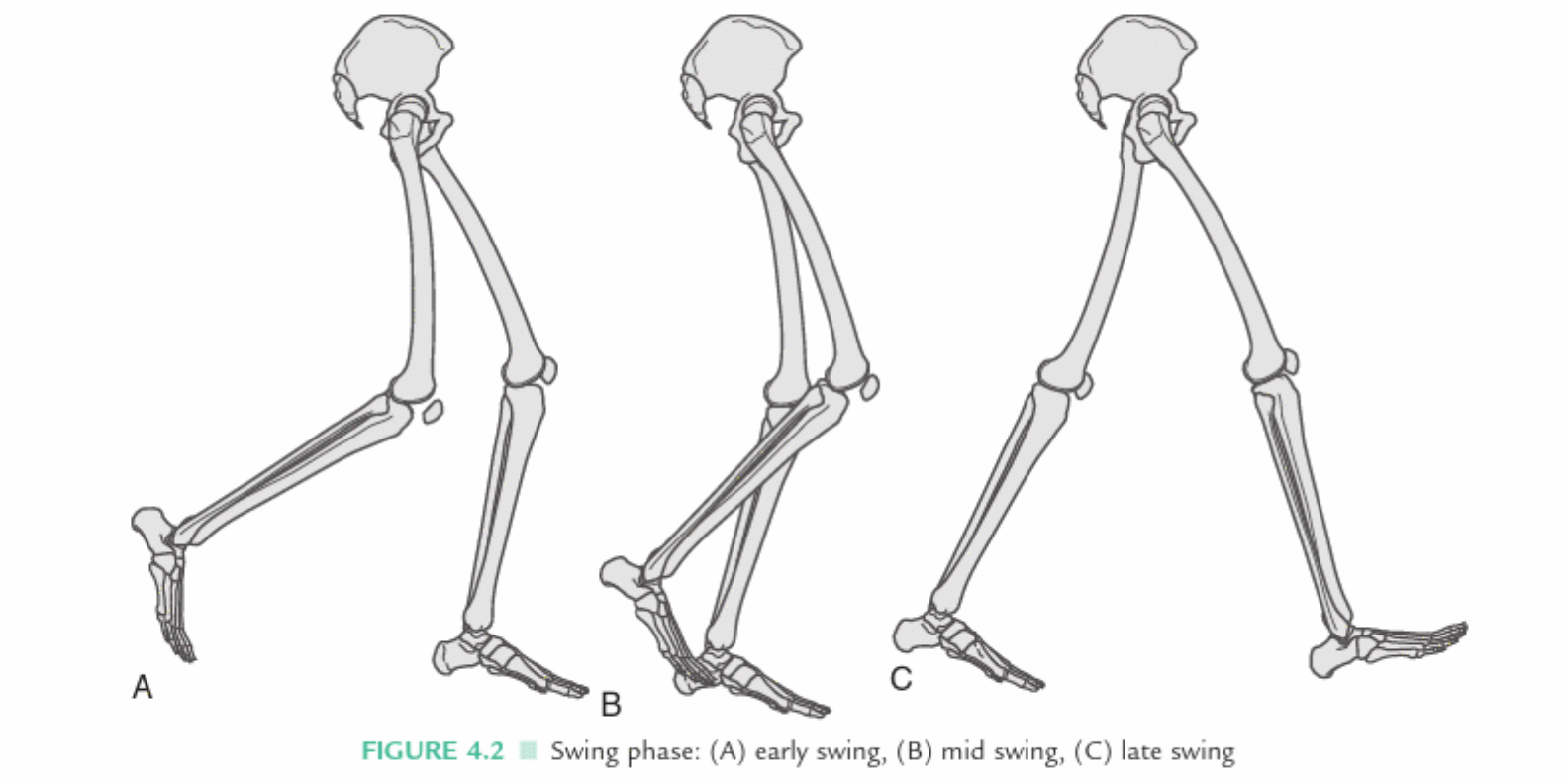
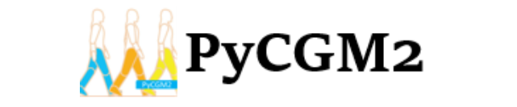
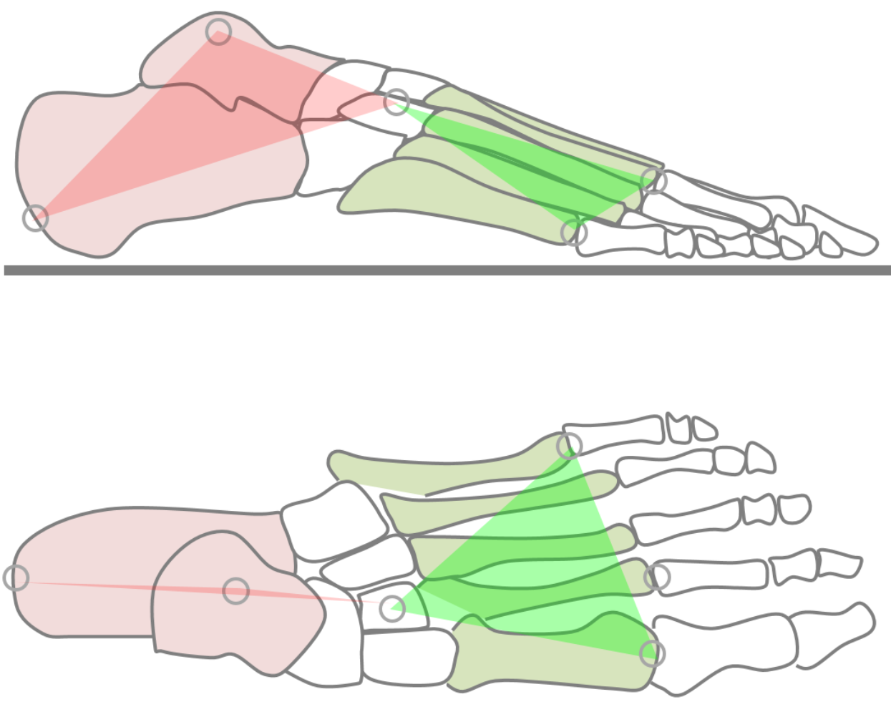
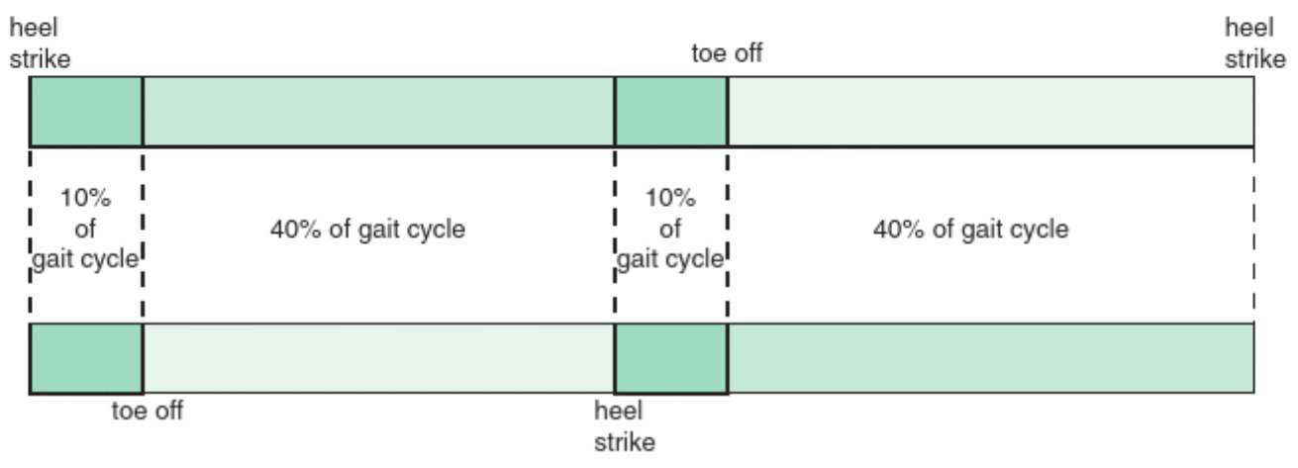
Individual Progress – Member 2
[Presenter with moxi0368]
Screenshot / Demo
Understand the background of the project.
Read some articles about FPA.
Understand the significance of the project.
Read the two resources recommended by the client.
Create a Microsoft shared document and invite each group member to co-edit the PowerPoint.
Excerpts from the article about FPA
Excerpts from the resources recommended by the client

Slide 8
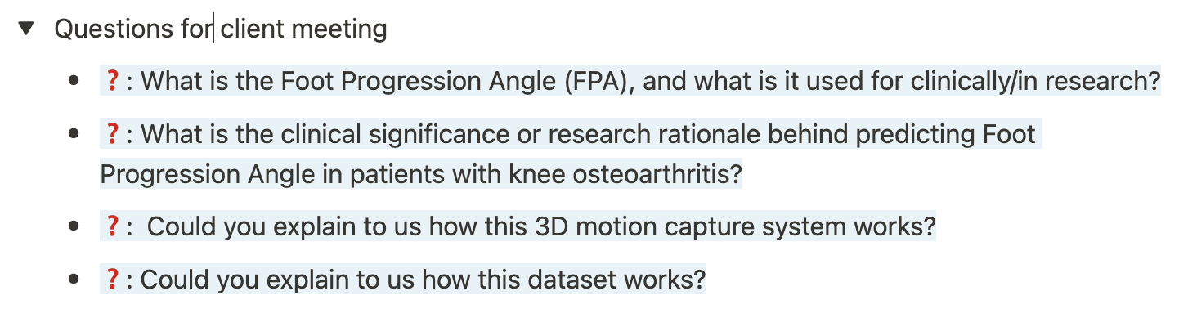
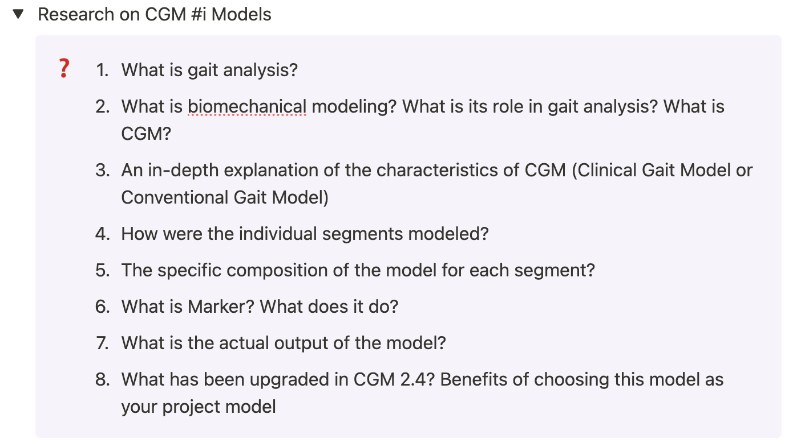
Individual Progress – Member 3
[Presenter with ruji6336]
Screenshot / Demo
Before the client meeting
Go through the project requirement and have a research on gait analysis
Prepare some questions for the client meeting
After the client meeting
Have a deep research on CGM #i Models which client recommend to study

Slide 9
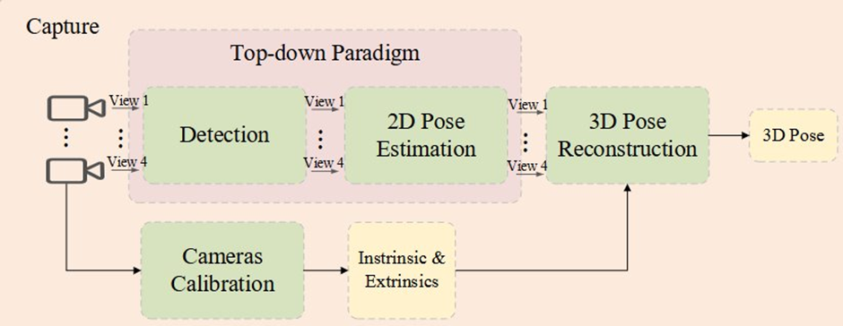
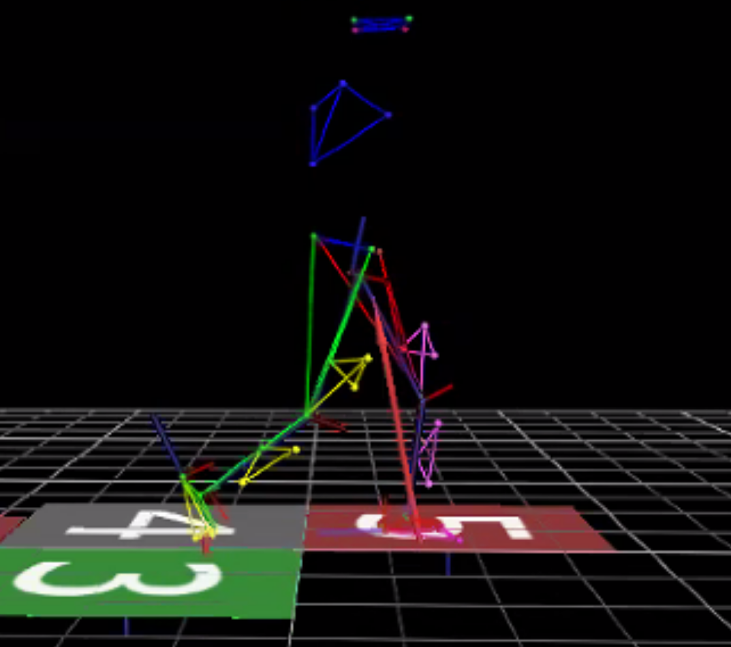
Individual Progress – Member 4
[Presenter with wchi0957]
Screenshot / Demo
Understand the project objectives
Learned about the features of the client-provided software, Vicon Nexus
Read the papers provided by the client
Read the articles on the integration of 2D and 3D data
Attended client meetings and team meetings

Slide 10
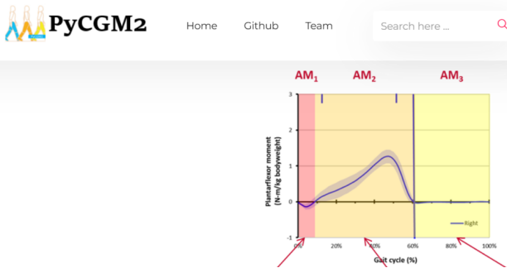

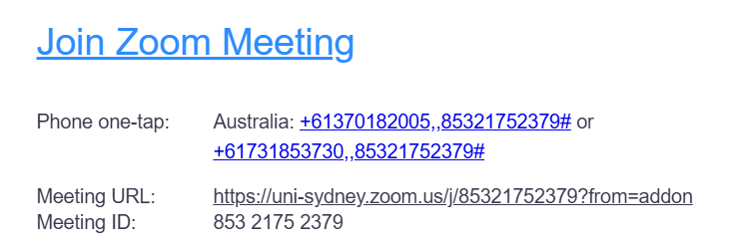
Individual Progress – Member 5
[Presenter with tliu0082]
Screenshot / Demo
Screenshot / Demo to support your progress
Engagement with the Client
Biomechanical Analysis and Data Understanding
Papers related to the project
Understanding of the background of the project

Slide 11
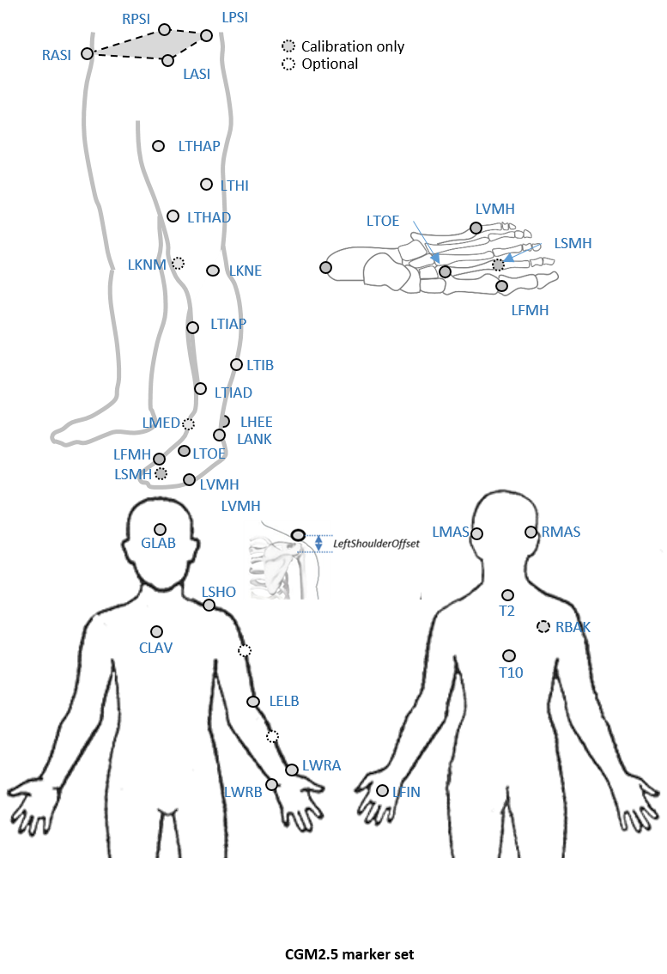
Individual Progress – Member 6
Screenshot / Demo
[Presenter with yguo0583]
One hour meeting(Comprehending the dataset, Setting the next progress)
Foot orientation in CGM & PiG:
I. CGM: Captures only long-axis orientation.
II. PiG: Estimates rotation using the heel marker (unvalidated).
After Meeting: I. The frequency of meeting: once a week.
II. Next Monday(2025/03/17) go to the lab.(We'll decide what the way to analytic the data)

Slide 12
Challenges & Issue
[Presenter with fwan0760]
Group-Level Challenges
Lack of knowledge in Biomechanics
Lack of experience in processing video data
Complex Data Structure
Individual-Level Challenges
Feixiang Wang: Review LSTM, GRU
Yang Guo: Review Attention and Transformer
Mohan Xi: Learn the knowledge about time series data
Weijia Chi: Introduce data features and structure to team members
Tonghuan Liu: Learn some knowledge about deep learning
Ruihao Ji: Focus on Video data and help team members to process them

Slide 13
What’s the plan before next tutorial?
Tasks/Goals for Upcoming Week
Task/Goal 1: Get the whole data and learn the data details
Task/Goal 2: Learn related knowledge in Biomechanics
Task/Goal 3: Read the paper related to this project
Task/Goal 4: Try to build the demo model and evaluate the difficulties
Assignment of Responsibilities
Feixiang Wang: Read and introduce papers to other group members
Yang Guo: Build the Demo Model
Ruhao Ji: How to process video data in computer vision area
Tonghuan Liu: How to process video data in computer vision area
Weijia Chi: Introduce data features to other group members
Mohan Xi: Introduce Biomechanics Knowledge to other group members

Slide 14
[Optional] Any Questions?
Question 1: Can we add more slides in tutorial presentation?
Question 2: Because of client arrangement, we cannot access the data until next Monday. The major works will start from next week which we will show in the next week presentation. Will this affect the score?
Question 3: When we record our zoom meeting, what information must be included?
Question 4: Tutor did not agree the invitation in the github. Can you agree with the new invitation we sent to you?

